Slide 1
Load Balancers (Fault Tolerance)
Classic LB
Application LB
Network LB
Auto Scaling Group
Scalability
Scale up
Scale down
Access Identity Management (IAM)
Create User→ user1, user2, user3
User group → myusergroup
Assign policy to myusergroup
Create custom policy
Question: once the custom policy is created can it be edited?

Slide 2
13. IDENTITY AND ACCESS MANAGEMENT
AWS Identity and Access Management (IAM) is a web service that helps you securely control access to AWS resources for your users. You use IAM to control who can use your AWS resources (authentication) and what resources they can use and in what ways (authorization).
Choose Identity & Access management under Security & Identity from the AWS console page.

Slide 3
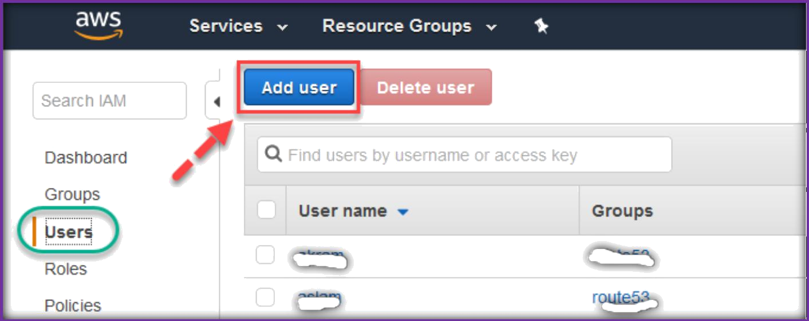
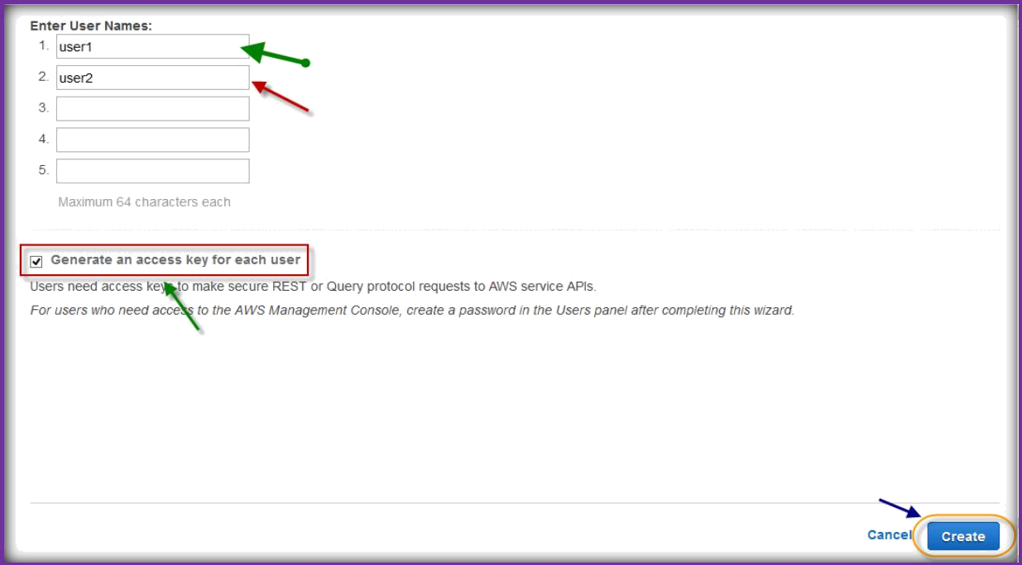
CREATING USERS:
Once you are on IAM page, Click Users from left pane, then choose Add User to create a user.
Specify user names in the text fields, if you do not want access keys for new users uncheck generate access keys, then choose Create.
On the next page, click on Show User Security Credentials to see access keys or choose Download Credentials to download them then click on close.

Slide 4
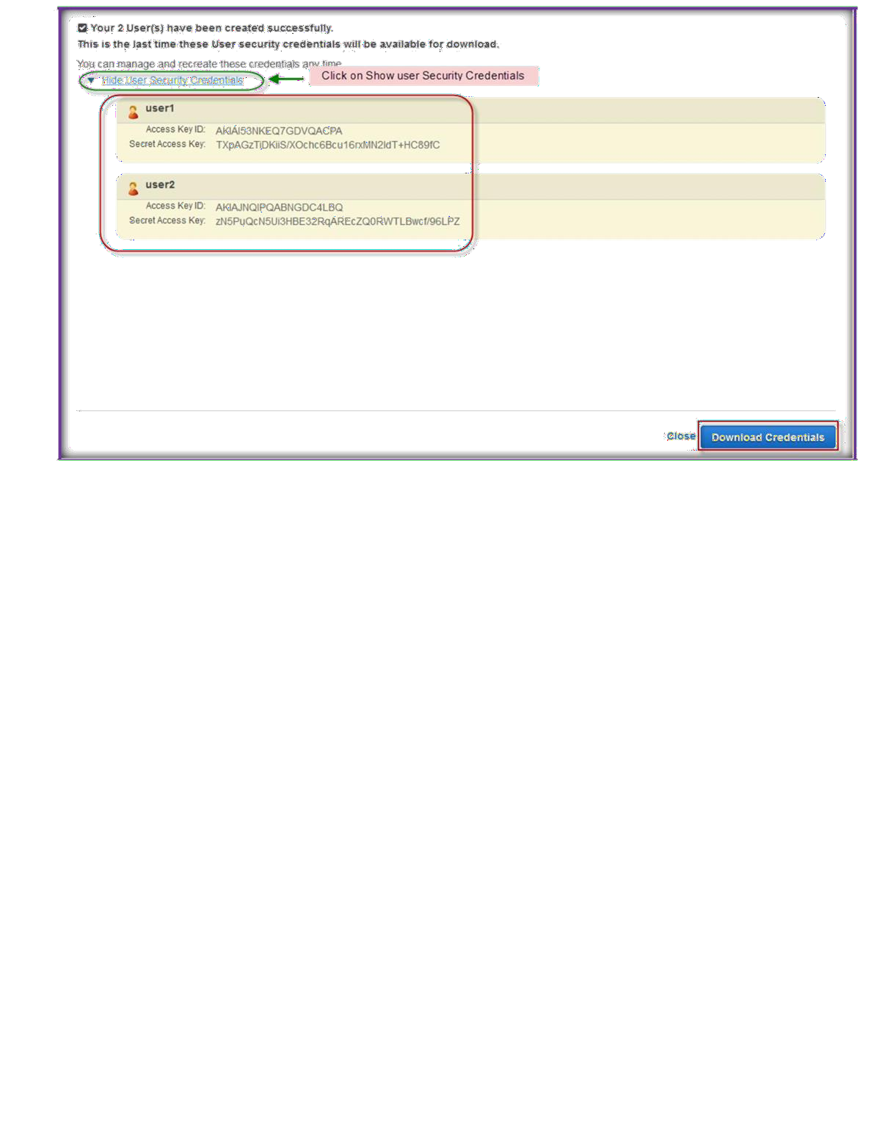
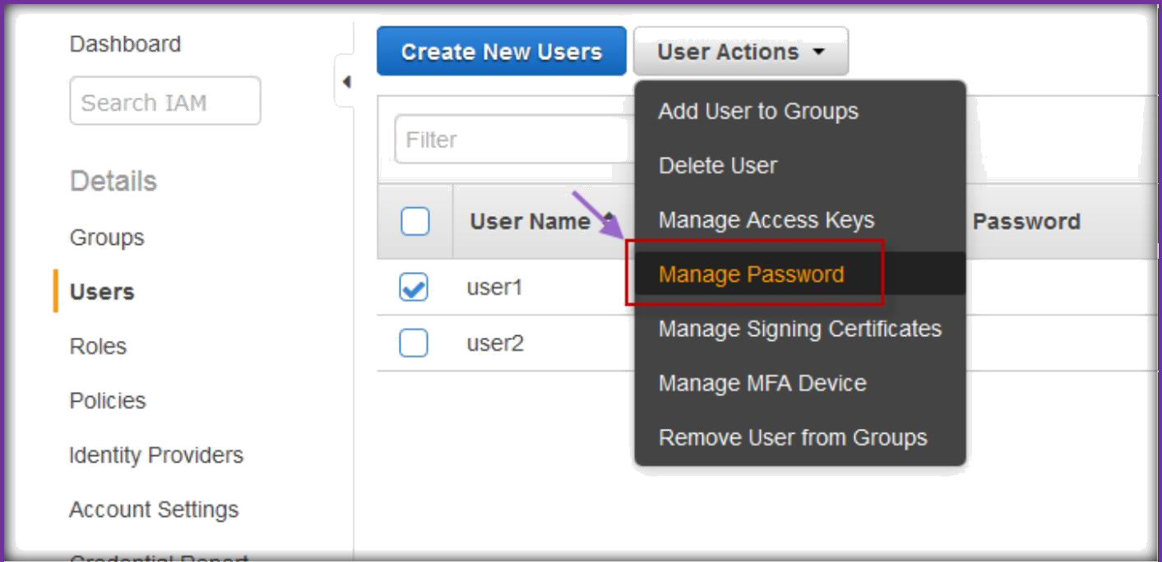
Under Users tab, select a user and click on User Actions, then select manage Password to create a new password.

Slide 5
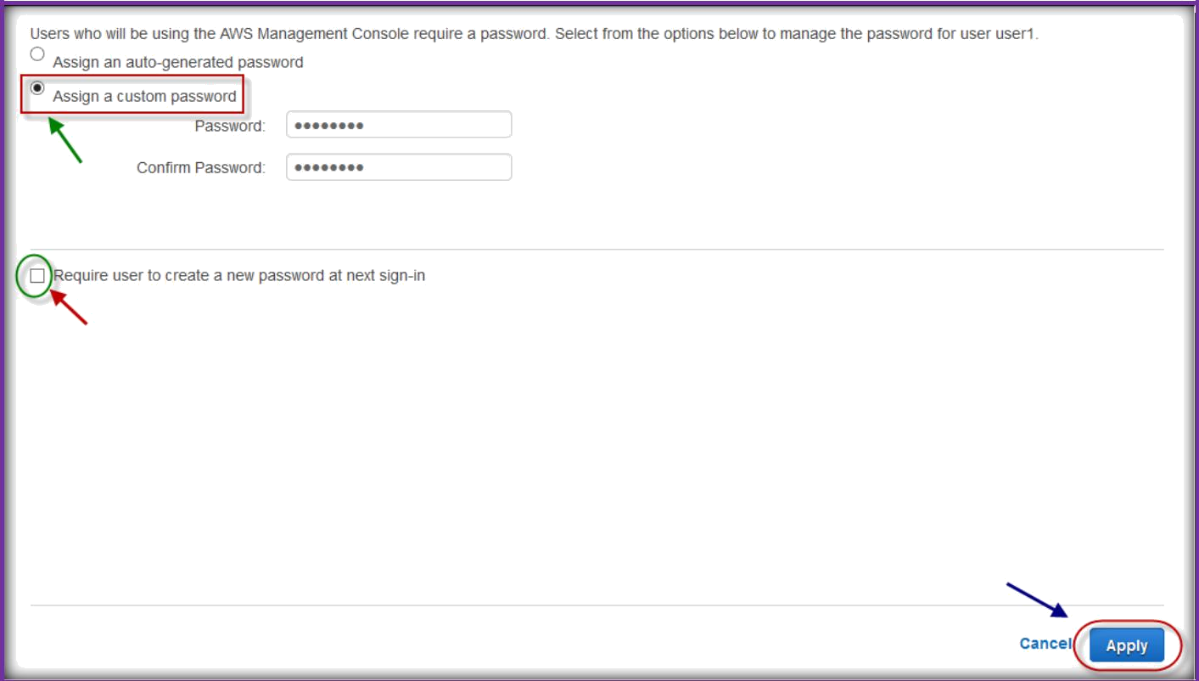
On the next page, choose either auto-generated or a custom password, then specify a password if you choose custom password.
Check box if you want user to create a new password at next sign-in, then choose Apply.

Slide 6
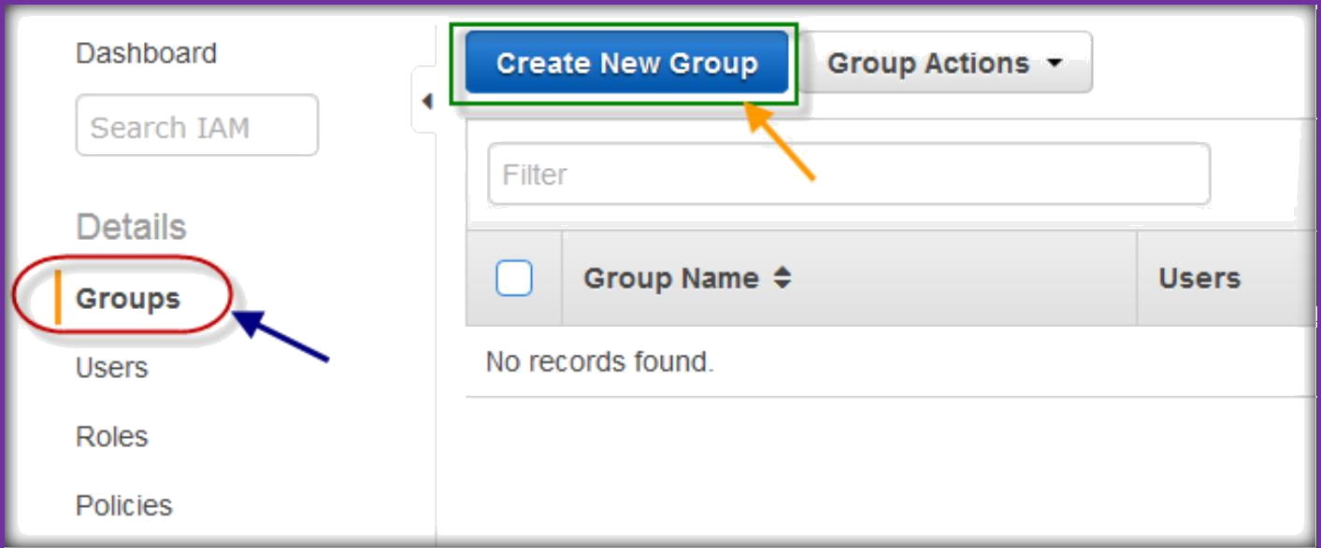
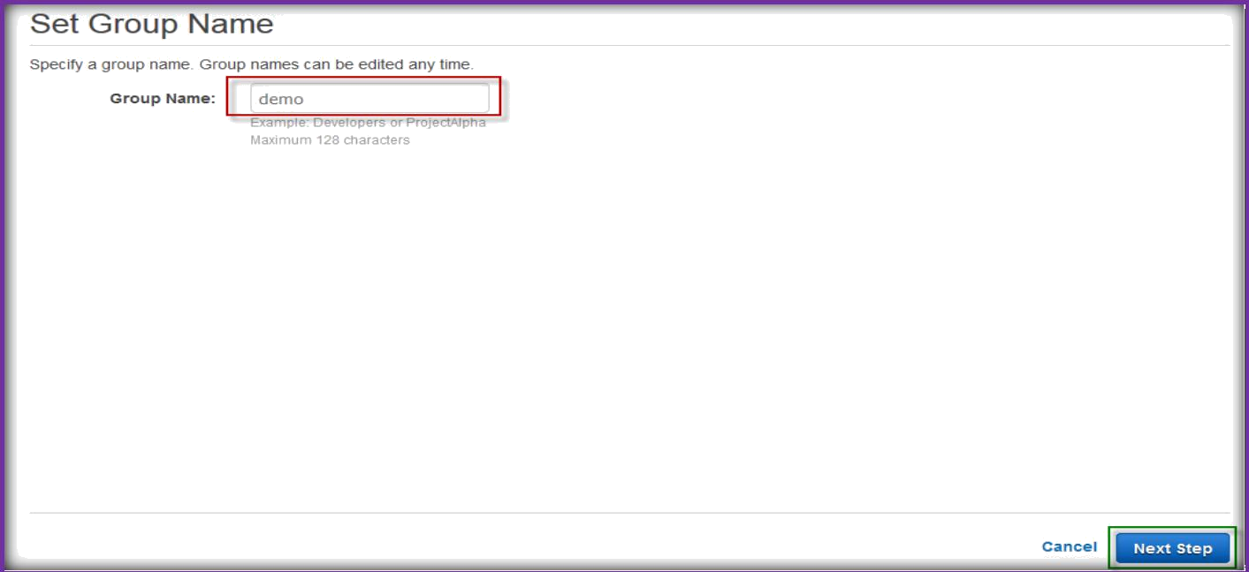
CREATING GROUPS:
Choose Groups from the left pane, then choose Create New Group to create a new one.
On next page, specify a new group name, choose next step.

Slide 7
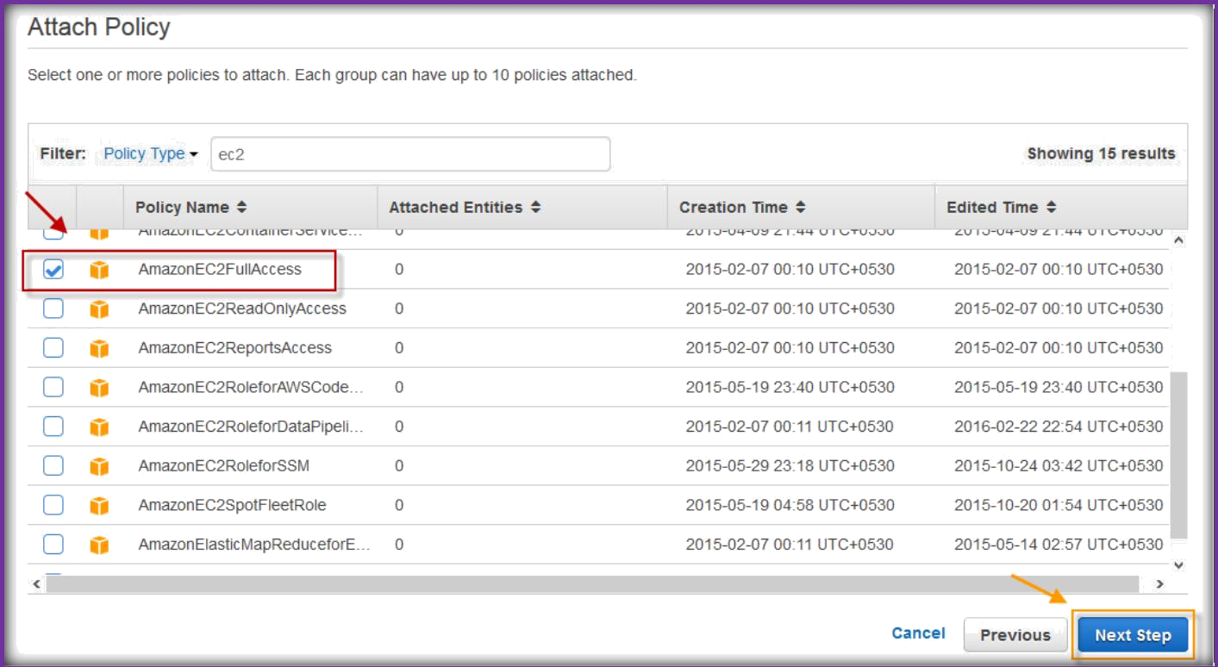
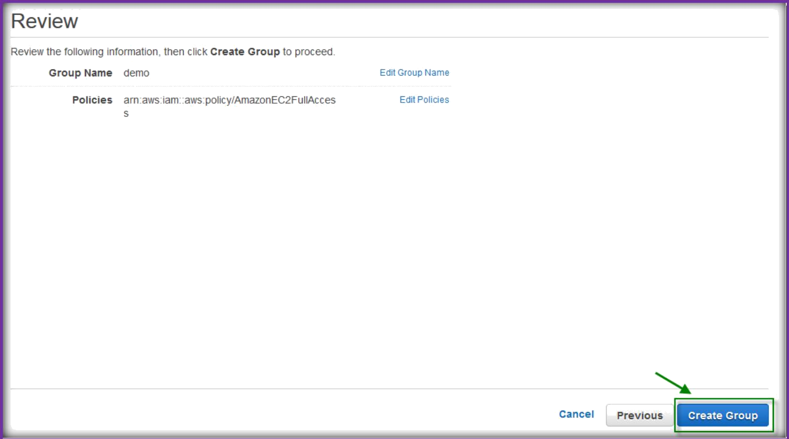
On the next page, search a service name of AWS in the policy type text field, choose one or more policies for group, then choose Next Step.
On the review page, choose Create Group.

Slide 8
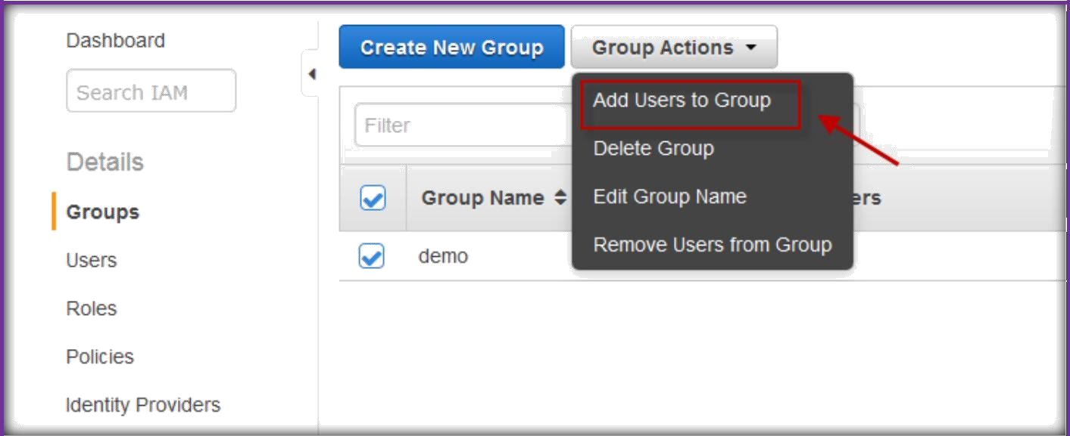
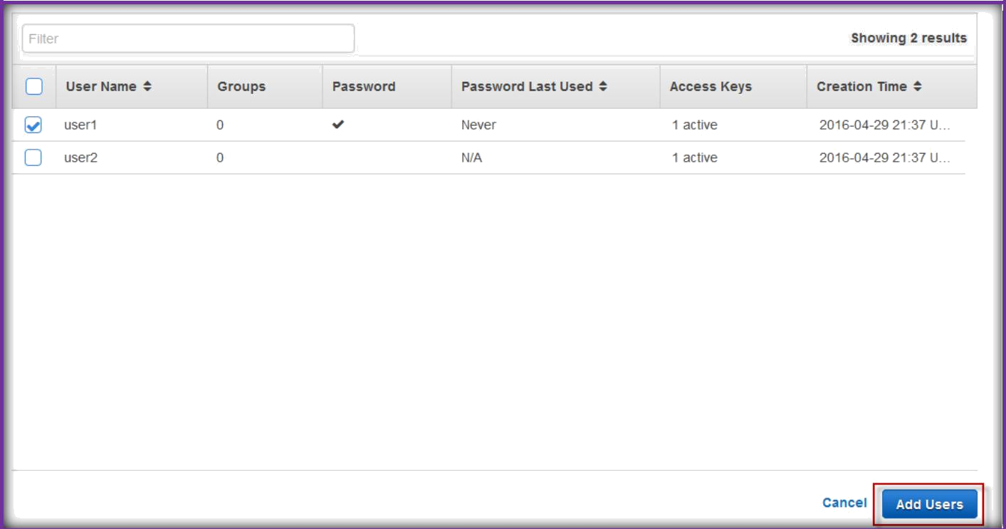
ADDING USERS TO GROUP:
select Groups from left pane, then select the group then click Group Actions. Under group actions choose Add users to Group.
Select users from the available users list then choose Add Users.
Now selected users will be added to your group.

Slide 9
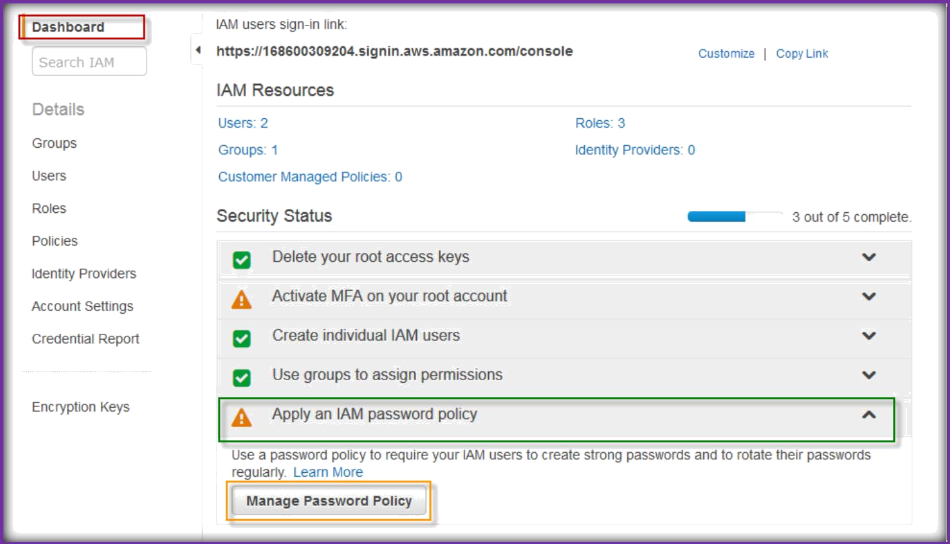
MANAGE PASSWORD POLICY:
Under IAM dashboard, expand Apply an IAM password policy, then choose Manage Password Policy.
Select options which you want then Apply Password policy.

Slide 10
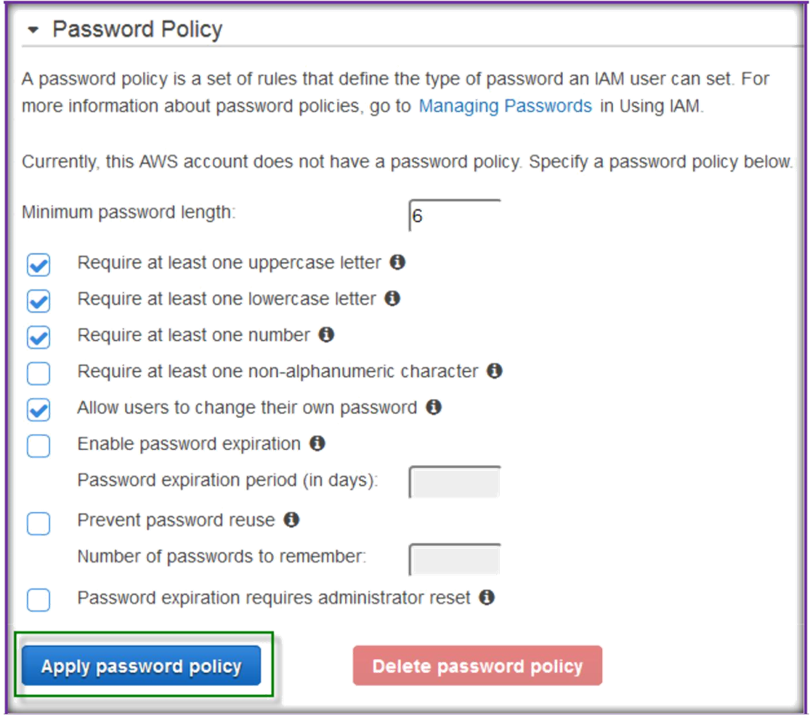

Slide 11
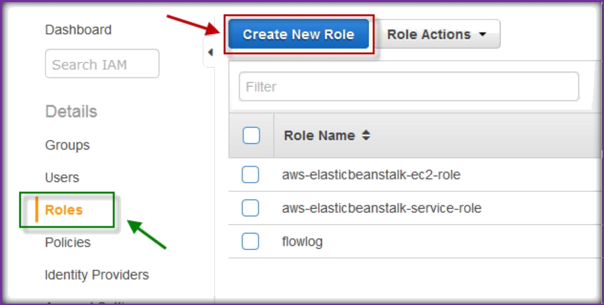
ROLES: An IAM role is similar to a user, in that it is an AWS identity with permission policies that determine what the identity can and cannot do in AWS. However, instead of being uniquely associated with one person, a role is intended to be assumable by anyone who needs it.
Also, a role does not have any credentials (password or access keys) associated with it.
Instead, if a user is assigned to a role, access keys are created dynamically and provided to the user.
Once you are IAM dashboard, choose Roles from the left pane, then click on Create New Role.
In the next page, specify a name for role and choose Next Step.

Slide 12
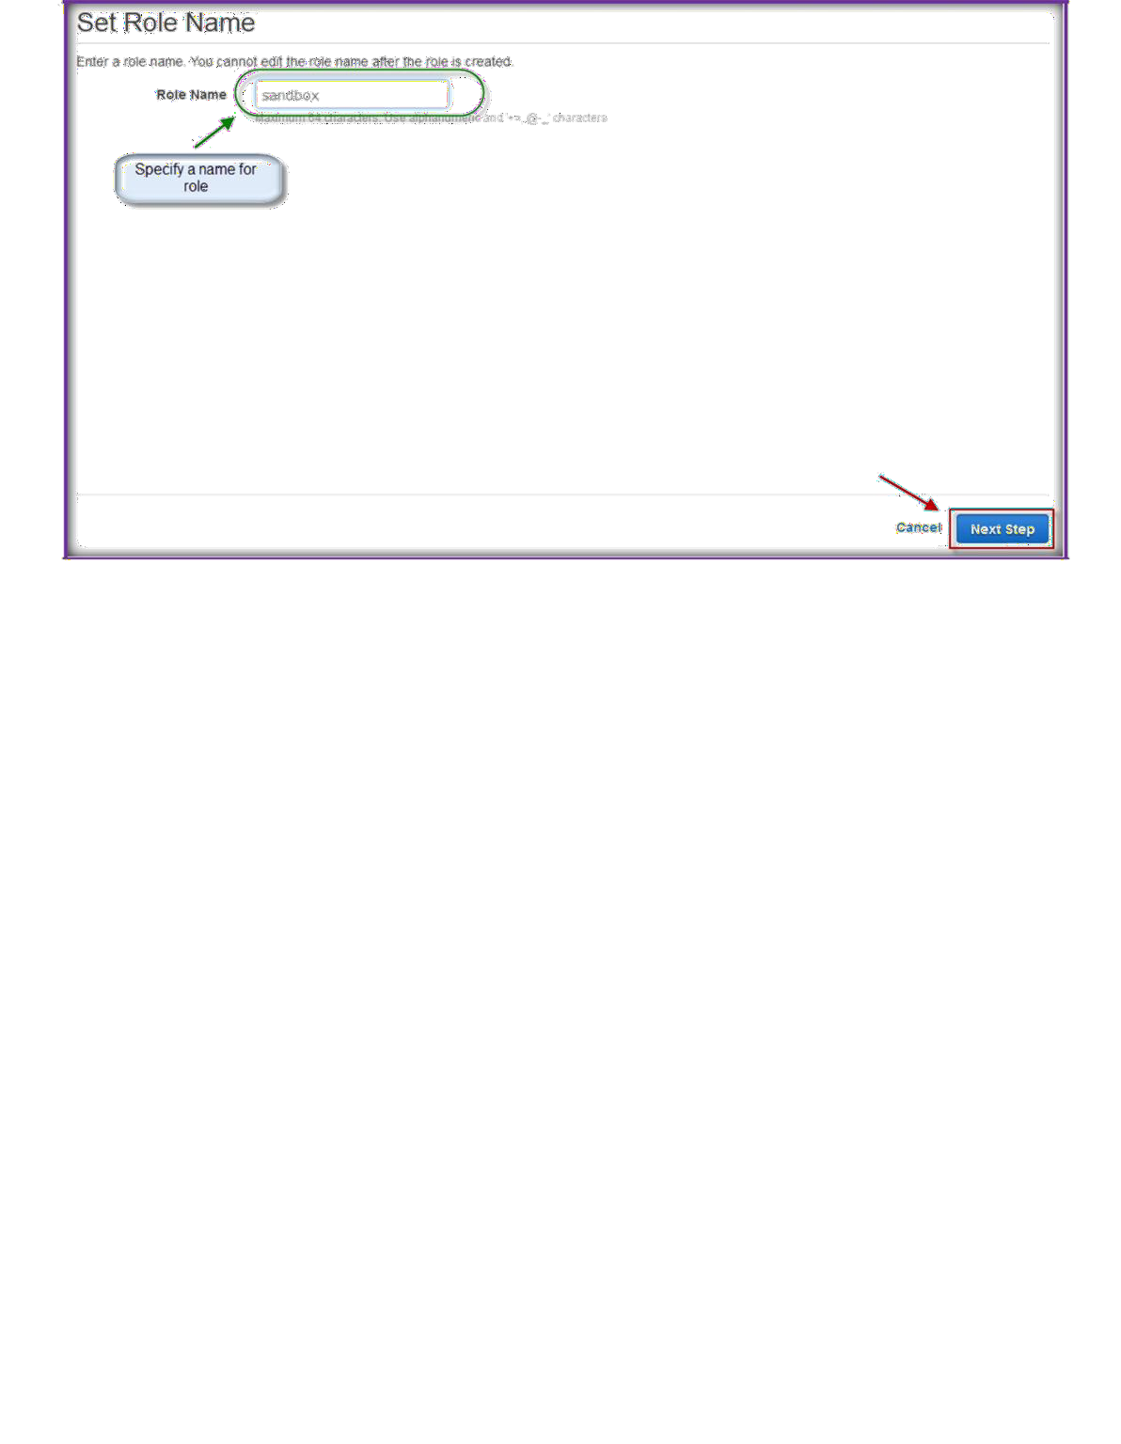
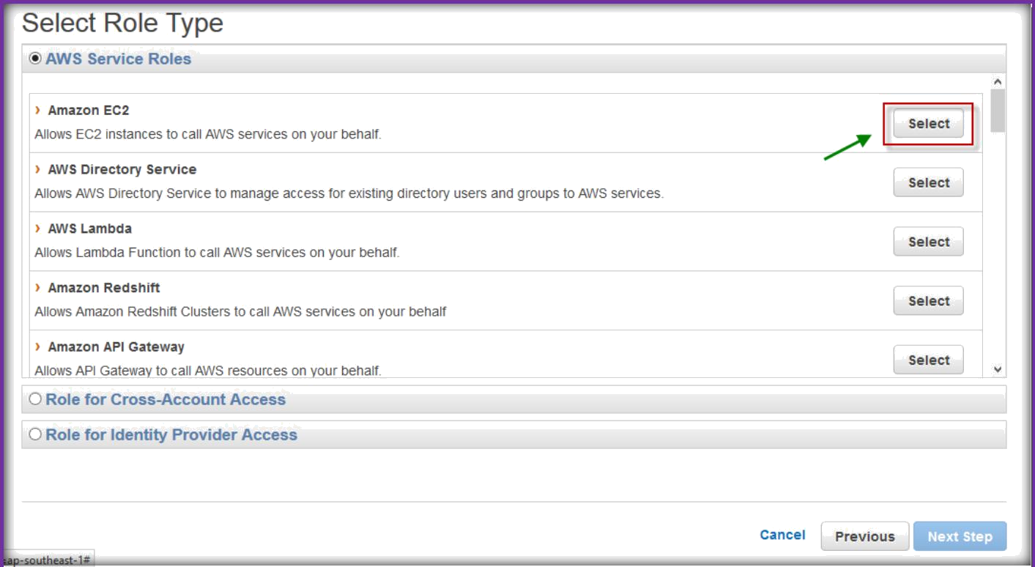
On next page, select role type, choose select button to respective AWS service.

Slide 13

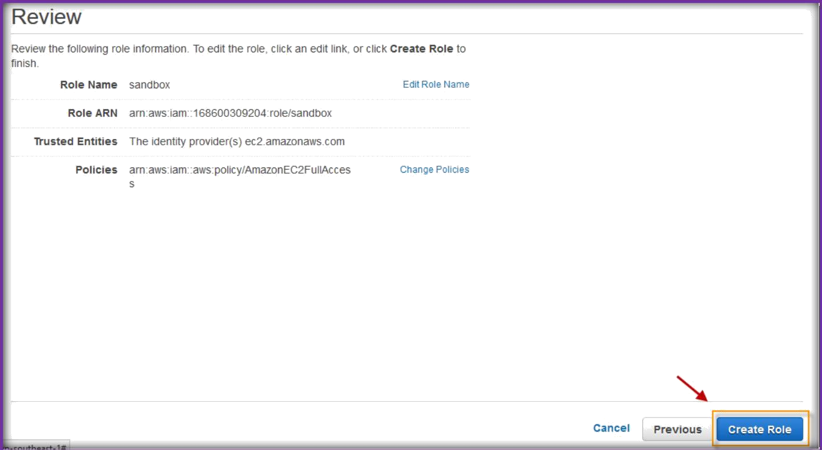
On the next page, search a service name of AWS in the policy type text field, choose one or more policies for group, then choose Next Step.
On the review page, choose Create Role.

